Slide 1




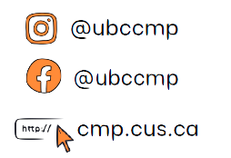

COMMERCE MENTORSHIP PROGRAM
REVIEW SESSION
COMM 204
Prepared by: Sang Nguyen and Tejsai Tagore
Instructed by: Tejsai Tagore

Slide 2
TABLE OF CONTENTS
FLOWCHART
KEY TERMS
CAPACITY RATE, BOTTLENECK ANALYSIS
LITTLE’S LAW
GANTT CHART
CRITICAL PATH (CRASHING ACTIVITIES)
P-K FORMULA
INVENTORY MANAGEMENT

Slide 3
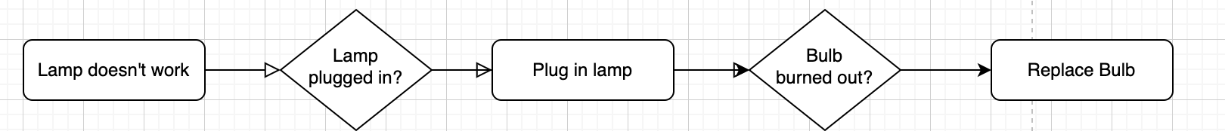
Flow Chart
Linear
Task | Duration
A | 10 mins
B | 15 mins
C | 12 mins
D | 15 mins
E | 8 mins

Slide 4
Key Terms
● Activity: A step in the process
● Resources: The performer of the activity
● Flow unit: The basic unit of analysis in any given scenario (customer, sandwich,
phone calls, etc.)
● Theoretical Flow Time/Flow Time: The amount of time a flow unit spends in a business process from
beginning to end.
● Unit load: Total amount of time that a resource needs to process a flow unit
● Capacity rate: Maximum output rate at which units can flow through a resource or
process
● Bottleneck: Resource/activity with the slowest capacity rate in a process
● Throughput rate/flow rate: Actual output rate of the process.
● Utilization Rate = Throughput rate / Capacity Rate <= 100%

Slide 5
Practice Question
For a certain chemical test at a medical company the below activity-resource chart is provided. Based on the information calculation the following.
The flow time of the process
The flowtime of the bottleneck activity.
Capacity rate of Person C
Capacity rate of the process
What happens to the capacity if there is another individual, Person F working alongside Person B?
What happens to the capacity if there is another individual, Person G working alongside Person E?
Person | Activity | Flow Time
A | Identify Requirements | 1 min
B | Testing Solutions | 3 min
C | Preparing Solutions | 2 min
D | Performing Reaction | 5 min
E | Test Analysis | 7 min

Slide 6
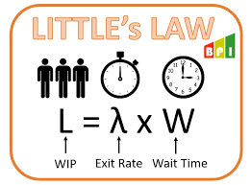
Little’s Law
Establishes a relationship between average inventory, average throughput rate, and average flow time:
I = R * T
Average Inventory (I): Average number of units or customers in the system
Average Throughput Rate (R): The average actual output rate
Average Flow Time (T): The average for a unit to move through the system

Slide 7
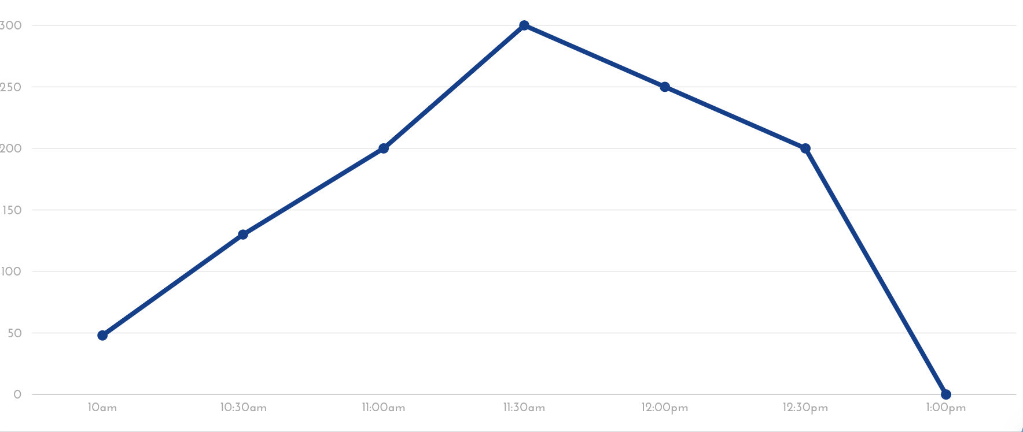
Practice Question
Below is provided the inventory buildup diagram at Lululemon for a surprise flash sale outside the UBC bookstore.
Using the diagram, calculate the average numbers of customers who visited the flash sale.

Slide 8
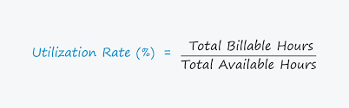
Throughput & Utilization
● Throughput rate/flow rate:
Actual output rate of the process. Depends on input rate & capacity rate:
If Input Rate < Capacity Rate: Throughput Rate = Input Rate
If Input Rate > Capacity Rate: Throughput Rate = Capacity Rate
● Utilization Rate = Throughput rate / Capacity Rate <= 100%

Slide 9
Practice Question
Below is provided the inventory buildup diagram at Lululemon for a surprise flash sale outside the UBC bookstore.
B) What is the average waiting time given that the throughput rate is 6 customers/hour?

Slide 10
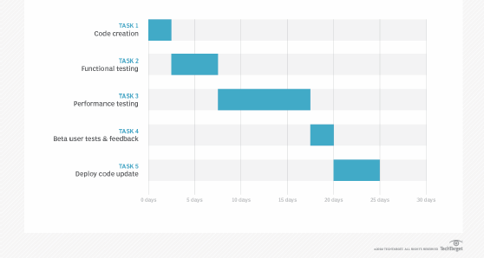
Gantt Chart

Slide 11
Critical Path
Critical path method:
● Identify all paths between the start node and the end node (Enumeration
Method)
○ For each path, add the activity times for all activities on that path
■ This path is called the critical path
■ This is the time required to finish the project
● Activity times are dependant on costs
● Crashing: refers to reducing the time it takes to complete the activity
● Crash time: the minimum possible time to complete an activity
● Crash cost: the cost associated with the crash time (in place of the normal
cost)

Slide 12
Practice Question
The LA Clippers are building a new arena and the construction process activity timeline is shown below. Please help the team figure the critical path & duration of the process.
Activity | Predecessor | Time (weeks)
A |  | 6
B | A | 3
C | A | 7
D | C | 2
E | B, D | 4
F | D | 3
G | E, F | 7

Slide 13
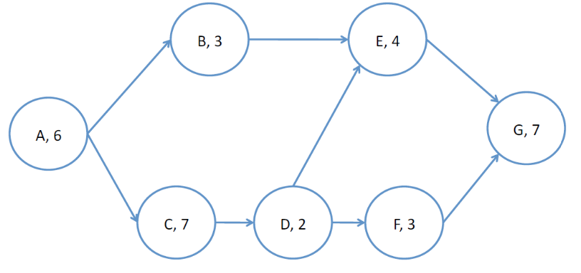
Practice Question
For the given project activity below, reduce the project completion time to 24 weeks if possible. Give the crashing cost as well. If not possible, clearly state why.
Activity | Predecessor | Time (weeks) | Crash Time (weeks) | Cost
A |  | 6 | 3 | $90
B | A | 3 | 2 | $40
C | A | 7 | 2 | $50
D | C | 2 | N/A
E | B, D | 4 | N/A
F | D | 3 | N/A
G | E, F | 7 | N/A

Slide 14
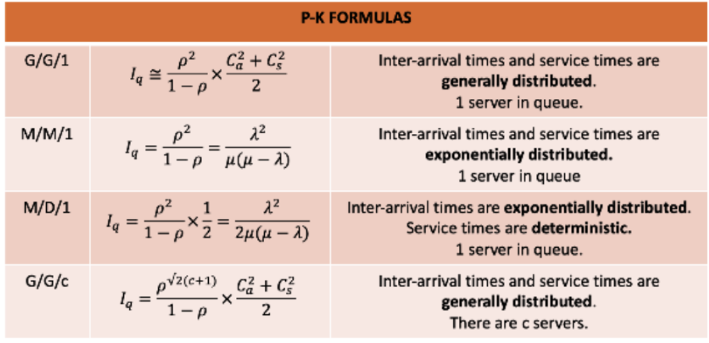
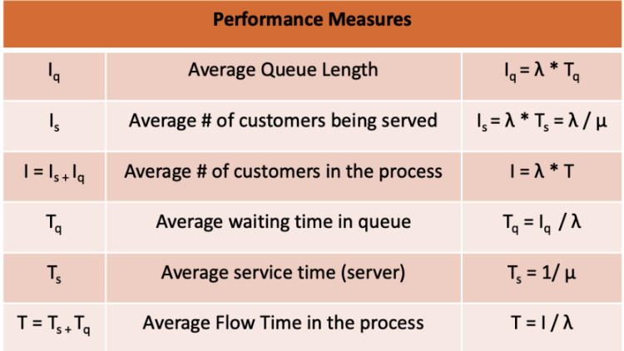
P-K Formula

Slide 15
Inventory Management
Variables:
D: Annual Demand Rate
Q: Batch Size
S: Cost
C: Cost per unit
I: Interest Rate
H: Annual Holding & Storage Cost [(2SDH)^½ ]
(D/Q)*S: Annual Setup Cost
(Q/2)*H: Annual Holding Cost
Q(opt): ((2SD)/H)^½
F(opt): ((DH)/2S)^½
Newsvendor Model:
Co: Overage cost, cost of having too much inventory
Cu: Underage cost, cost of having insufficient inventory
NV Ratio: Cu/(Cu+Co)
S: mean + sd(z-score)
P [D<=S]: Cu/(Cu+Co)

Slide 16
Practice Question
The NBA has an annual demand for 1000 Lebron James’ jerseys. The processing cost is $500 and each jersey costs $50, with a 5% carrying interest rate.
What is the restock frequency?
Find the optimal quantity
What is total annual cost?
What is the reorder cost?

Slide 17
Inventory Management (cont’d)
Different Types:
Moving Average: Ft = [A(t-1)+A(t-2)+......+A(t-n)]/n
Weighted Moving Average: W1A(t-1)+......+WnA(t-n)
Exponential: F(t-1) + α(A(t-1) - F(t-1))
Forecasting:
Ft: Forecast at time t
At: Actual inventory at time T
n: periods
w: associated weight value

Slide 18
Practice Question
Look at the table below: Find A, B, C, D. Write N/A where applies.
Month | Demand | Forecast (3 months)
January | 500 | A
February | 600 | B
March | 750 | C
April | 1000 | D

